Slide 1
WCM in SP2013
Name
Title
Company

Slide 2
Agenda
SharePoint 2013 WCM Platform Improvements
Managing Content, Navigation and Authoring
Content Reuse
Branding Sites
Usage Analytics
Multilingual

Slide 3
WCM Platform Improvements
SharePoint 2013 unifies SharePoint 2010 platforms
FAST Search Server 2010 for Internet Sites
SharePoint Server 2010 for Internet Sites
WCM as a Search-Based Application
Use traditional “authored content” (SharePoint 2010)
Consume & integrate indexed content into Publishing site
Leverage the new SharePoint App Model to inject common applications
Notes:
FAST Search Server 2010 for Internet Sites brings the following:
Easily managing content transformation through powerful processing tools
Advanced scalability, flexibility, connectivity and linguistics with FAST ESP
Open & extensible platform, no code customization, familiar development tools
SharePoint Server 2010 for Internet Sites brings the following:
Taxonomy driven navigation & page URLs
Create, edit, translate, approve, schedule, publish and expire content
Built-in user experiences for authors & visitors
With these new changes to search, WCM sites can now be implemented two different or mixed ways:
Structured Authoring: This is done by navigating to a location in the site & creating content page-by-page. This is how WCM sites were created in pre-SharePoint 2013.
Search Based Sites: This new scenario, facilitated by the improvements in search in SharePoint 2013, involves rendering pages directly from the search index. This means that existing product databases or content not living within SharePoint can easily be included in WCM sites in SharePoint 2013.
These two scenarios are not mutually exclusive… they can very easily be mixed.

Slide 4
SharePoint 2013 WCM Pillars
Engaging Experiences
Easier to implement custom brand
Easier to implement mobile experience
Taxonomies
Clean URLs
Utilizing new SharePoint 2013 App Model
Comprehensive Content Management
Authoring
Content Lifecycle
Multilingual improvements
SEO
Item Catalogs
Content Reuse
Dynamic Content
Automatic topic pages
Relevance
Recommendations
Fast to Market
Web Designers
Developers
Office 365
Your Content + Best of Web
Content Authoring
Content Reuse
Content Crawl
Catalogs
Notes:
You can look at SharePoint 2013 WCM around some guiding pillars:
Engaging Experiences: WCM sites are not easier to implement & brand for traditional desktop browsers as well as for mobile devices such as phones & tablets. By using taxonomies, sites are much easier to navigate and consumable by users visiting the site. Clean URLs (no /Pages or .aspx in the path) provide site implementers the most flexibility in crafting SEO friendly URLs.
Comprehensive Content Management: WCM leverages all the existing and new capabilities the lifecycle of content included in the SharePoint platform. A new feature, catalogs, facilitate content reuse across multiple sites.
Dynamic Content: With the new metadata based navigation & dynamic URLs, SharePoint introduced automatic topic pages that will show all content in the site matching the taxonomy reflected in the URL. The new analytics engine is built for scale and is used to drive relevance and recommendations for users browsing the site.
Fast to Market: New investments such as the SharePoint App Model & the Design Manager make it easier for developers and web designers alike to create rich and engaging experiences quickly.
Your Content + Best of the Web: Not only can you create sites using structured content authoring but the improvements to the platform around search facilitate search based sites and inclusion of content not only from the existing site but from external sources as well.

Slide 5


SharePoint 2013 Content Model
Shared Metadata
Rollup Page
Product Page
Authored Content
Indexed Content
Federated Content
Item Catalog
Item Catalog
Reusable Content
External Content
Notes:
The new content model for SharePoint 2013 sites is centered on two main components: the search index & shared metadata. The metadata, facilitated by Managed Metadata taxonomies, drives the navigation and ability to find content both in the index as well as traditionally authored content. The search index consists of content coming from content catalogs and other sources configured using the search management tools. SharePoint automatically generates rollup pages for each term in the taxonomy which lead to detail pages. Each of these pages is a template which can be customized by developers.

Slide 6
SharePoint 2013 WCM & App Model
Publishing sites can utilize the new SharePoint App Model
Content Production
Account Management
Survey
eCommerce / Transaction support
In-Page Integration
Weather
Social “like” button
Analytics script
Outsourced commenting on page
Mobile Companion
Many sites have companion apps
IE: Engadget, MSNBC, Live, etc.
Notes:
The new SharePoint App Model can be leveraged within SharePoint 2013 Web Content Management sites to extend add capabilities to the user experience. Such apps could be content production apps that support eCommerce, surveys or account/profile management or apps that integrate content into a page such as displaying stock quotes, weather, social commenting capabilities or analytics scripts. Finally apps could be used to create mobile companions to the site as many leading sites do.

Slide 7
Taxonomy in SharePoint 2013
Taxonomies introduced in SharePoint Server 2010
SharePoint 2013– Building & delivering on SP2010
Improvements & Additions:
Added concept of “intended use”
New management pages (so Term Store Manager isn’t req.)
UI for management of custom properties on terms
Notes:
SharePoint 2010 introduced the Managed Metadata Service which provides taxonomy services to SharePoint sites. SharePoint 2013 builds and delivers on the potential and promises of what SharePoint 2010 introduced.
Some of the investments & additions to taxonomy in SharePoint 2013 include:
Added CSOM interfaces for working with term sets off the server.
In SharePoint 2010, anyone could read term sets in a group, only some could write to it. SharePoint 2013 adds read/write permissions to groups.
Term sets now have an “intended use” property to indicate if it should be used for tagging, search, navigation, etc.
New management pages were added to reduce the number of people & instances that needed to access the Term Store Manager administration tool.
SharePoint 2010 enabled the copy & reuse of terms. SharePoint 2013 introduces pinning which is like reuse, but it blocks any changes where it is being reused. A term set or a set of terms can be pinned.

Slide 8
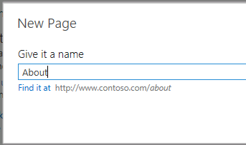
Site Navigation & Topic Pages
Navigation based on taxonomy
Enables clean URLs (www.contoso.com/careers)
Enables multilingual URLs
Allows for easy reorganization of content by modifying the term set
Automatic generation of term-driven page
“Home page” for a term » contains search results for a term
Template can be customized by designers & developers
Notes:
The new navigation structure in SharePoint 2013 will use taxonomy to generate the URLs and paths to content. Even when creating new content, SharePoint will automatically add a new term to the taxonomy that maps to this new page.
When navigating to a term that points to a rollup page, SharePoint will automatically generate a Page Layout (.ASPX) that will be used to display the contents. Developers & designers are free to update this template to use specific display templates using within the content by search web part.

Slide 9
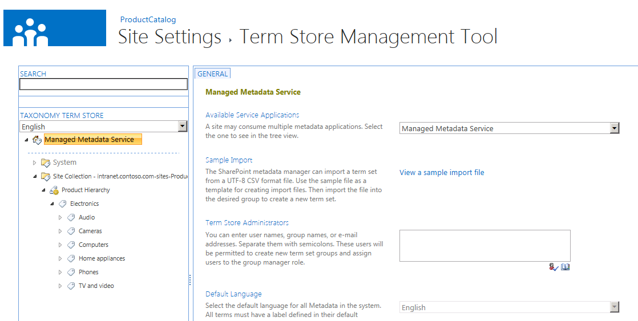
Managed Navigation
Drive your navigation and URLs based on Term Store hierarchies
Clean URLs for actual end users
www.contoso.com/careers
www.contoso.com/aboutus
Define settings for navigation in terms store manager
Provides also dynamic topic pages capability for minimizing amount of physical pages for catalog type sites

Slide 10
Structured Content & Managed Navigation
demo

Slide 11
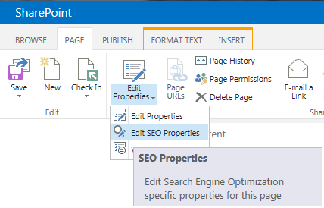
Search Engine Optimization improvements
Numerous SEO improvements in site and page level
Features | SharePoint 2010 | SharePoint 2013
Clean URLs | http://www.c.com/Pages/cars.aspx | http://www.c.com/cars
Home Page Redirects | HTTP 302 for http://www.c.com to redirect to /pages/default.aspx | Home page served from address www.c.com – no redirect for browser
Country code top-level domains (ccTLDs) | http://www.c.com/en-us/Pages/cars.aspx http://www.c.com/es-mx/Pages/coches.aspx | http://www.c.com/cars http://www.c.mx/coches
XML Sitemaps | None | Automatically generated and referenced in robots.txt
SEO Properties (e.g. Meta Description) | <title> and <h1> must be identical | Browser title Meta description Meta keywords
Webmaster Tools integration | None | Assists with ownership verification
Notes:
Microsoft paid special attention in SharePoint 2013 to search engine optimization (SEO). The table on this slide depicts some of the important changes in this release.
A big change involves the home page redirect HTTP status code returned when a user browses to a page. Previously a HTTP 302 status was returned which simply tells the requestor that the resource was found. For search engines this isn’t desired… rather it is more helpful to return a status code of HTTP 301 which says “this resource should now be found here”, telling the search engine to update it’s reference.

Slide 12
SharePoint 2013 WCM CSOM
SharePoint 2010 content available off the server using same CSOM & REST as SharePoint Foundation
No context around Publishing
Required intimate knowledge how Publishing worked
SharePoint 2013 Publishing surfaced via CSOM
Microsoft.SharePoint.Client.Publishing.dll
Microsoft.SharePoint.Client.Taxonomy.dll
Notes:
Because WCM sites are based on SharePoint sites, lists & libraries, developers could use all the standard APIs to interact with the content. This includes the server-side API and client-side APIs. However this meant that developers had to have a firm understanding of how the content was managed in these libraries. A better approach was to leverage the Publishing namespace in the server side API. This was also true for the taxonomy which had a robust server-side API.
Unfortunately these special namespaces were only available in the server-side API in previous versions of SharePoint. SharePoint 2013 changes this by adding a Publishing & Taxonomy namespace to the client side object model (CSOM) enabling client-side & remote development opportunities.

Slide 13
Cross Site Publishing & Catalogs
New list functional characteristic: Catalog
Flagged in search for pre-defined search queries
Enables content to be “published” across site collections
Facilitates real content reuse
Content surfaced throughout site collections via Content by Search Web Part (CBS)
Notes:
WCM sites are driven by content which may be products, articles or anything else. With the new search & navigation capabilities added to SharePoint 2013 WCM sites, Microsoft has also made it easier to manage content by the introduction of Catalogs. A catalog is a special type of SharePoint list that is registered within search for pre-defined queries. Once a catalog has been created, it can be published and shared across site collections. This allows customers to have a content authoring site, working with products or articles or whatever type of content in a list-like fashion while rendering it in a different way.

Slide 14
Content by Search Web Part
Similar to Content by Query Web Part
Exposes results as JSON on page
Customize search results rending
Easier to customize than CBQ styles
Client-side solution using returned results as JSON
Server side via custom Display Templates
Content is only editable at the source, not in different presentations (presentation = search results)
Notes:
Previous version of SharePoint WCM sites included a powerful web part used for content aggregation and rollup: Content by Query Web Part (CBQ). New in SharePoint 2013 is the Content by Search Web Part (CBS).
The CBS, when placed on a page, allows developers & designers to pull content directly from the search index. The query can be designed to pull content based on values on the page or within the URL, such as terms in a term site. The results are then written to the page in JSON format and a display template is used to render the content in HTML.
When search engines hit the page, SharePoint detects this is not a regular user and instead renders the HTML server side so the engine does not parse through the JSON, rather it parses the standard HTML page. There is also a property on the CBS Web Part that allows developers to force server-side rendering if they choose as in the case for accessibility reasons.

Slide 15
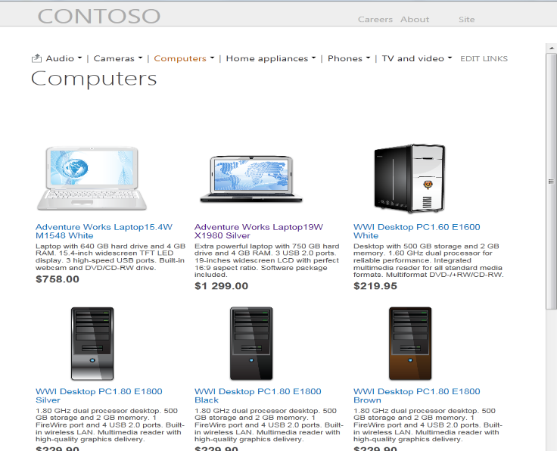

Navigation, Search and Topic Pages
Friendly URL
http://contoso.com/computers
TERM STORE
NAVIGATION TAXONOMY
CONTENT SEARCH WEB PART
Filter query by
CATEGORY: COMPUTERS
Audio
Cameras
Computers
Home appliances
Phones
TV and video
Search
Use page
maincategory.aspx
Product Catalog
Notes:
The picture in this slide shows how all the pieces of managed navigation, CBS, display templates and search all come together to construct a dynamic page pulling products from a catalog using the CBS and displaying them using a display template.

Slide 16
Content Catalogs, Topic Pages & Content By Search
demo

Slide 17
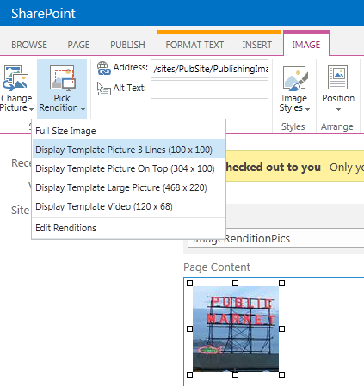
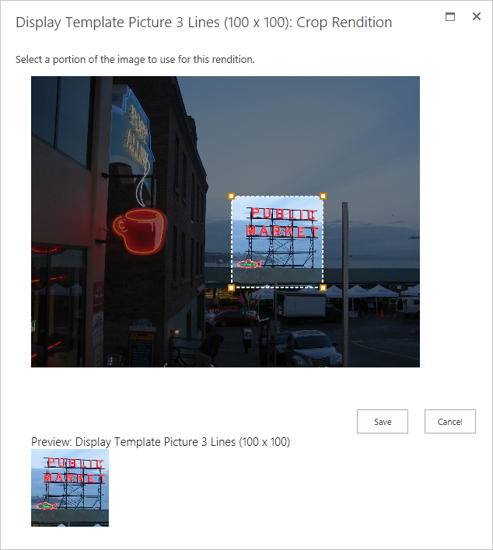
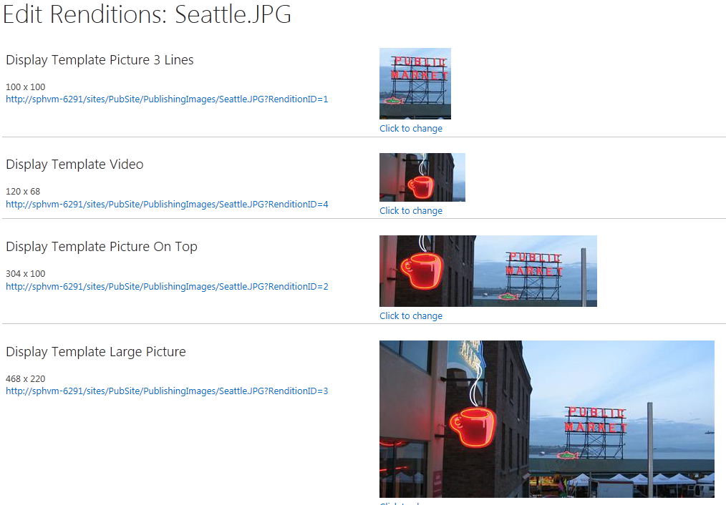
Image renditions
Image transformation dynamically in SharePoint
Renditions are actual thumbnails
Thumbnails on created on fly and cached for following requests
Consistency sized images
Resizing will resize actual image, not only it's presentation
Optimizes page payload
Cropping for targeting areas of pictures
Notes:
A major part of the Image Renditions value proposition that’s worth calling out on this slide is that the cropped images’ file size is also reduced, so a 4 MB image with a rendition would only result in a 400 kb download.

Slide 18
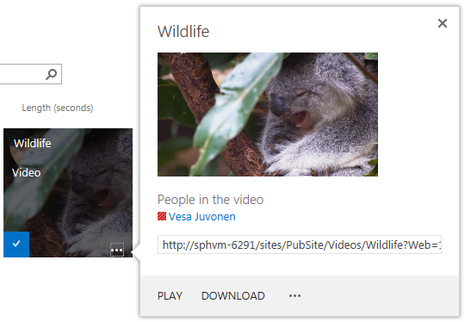
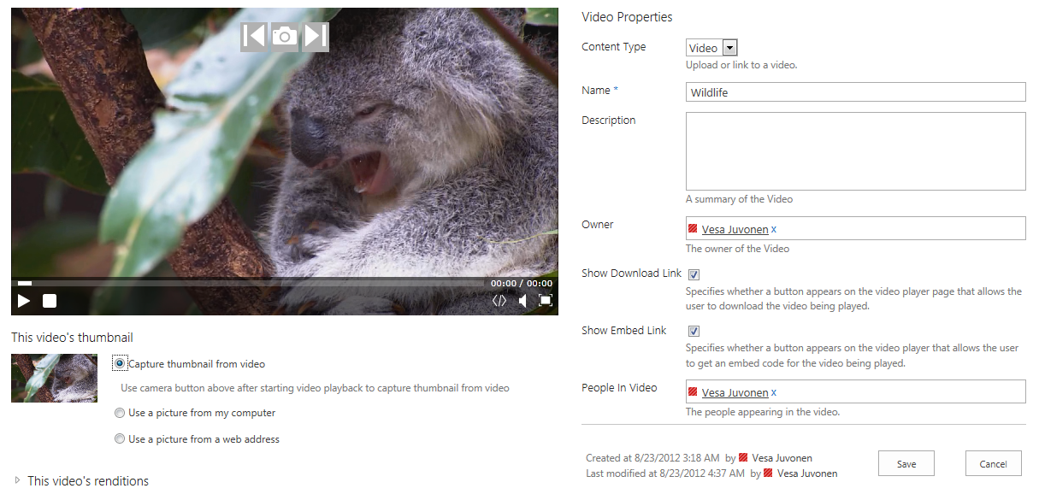
Video improvements
Enable easy enterprise podcast scenarios
Video support improvements
Embedding to any content page
Thumbnail generation
Renditions also for videos
External video support to store
Multiple encodings for single video
Video player as HTML 5 implementation
Fallback to Silverlight
Notes:
Default Video control is HTML5, if browser supports that and video matches supported types. Fallback using Silverlight
· Video player page out of box with: HTML5 video player (with Silverlight fallback for unsupported types) and metadata about the video and all the properties the user fills in like name, description, owner, people in video, keywords. Option to provide a download link and an embed code for your video. Ability to add related items by simply dragging and dropping the relevant files that you feel the viewers of this video should view. The users also have the ability to choose thumbnails or use auto-generated thumbnails.
· Tagging, ratings, number of views/unique users can be tracked using analytics. Also the ability to use videos in places like site/user feeds.
· You can create different renditions of the videos that the user can switch (low res / high res. Etc.)
· Video is a first class citizen in search so that search results that are videos contain relevant information such as number of views, length. There is even a “Videos” search vertical, like the “People” vertical.
· Ability to add videos from other locations, such as youtube or any other URL.
· Streaming support for the videos is still possible through the BLOB cache in SharePoint.
Video renditions -

Slide 19
Implementing Custom Branding
Empowering Web Designers
Completely revamped CSS classes
Minimizing ramp up time
Develop SharePoint 2013 sites in any Web Design tool
Expression Web, Adobe Dreamweaver, Notepad, etc…
New “Design Manager” tool makes it easier to implement custom branded sites
Notes:
Branding WCM sites is now much easier in SharePoint 2013 with the Design Manager. SharePoint allows developers & designers to copy non-SharePoint specific design assets and upload them to SharePoint. Then, with a behind-the-scenes automatic creation of SharePoint specific assets (*.MASTER & *.ASPX), designers can work with the HTML files in any tool they are comfortable with, getting a real design-time preview of the pages they are working within.

Slide 20
Design Manager: Implementing a Custom Brand
Wizard-like experience
Step-by-step Approach:
Upload design assets (HTML, CSS, images, etc.)
Create master pages
Create page layouts
Server preview of current state of design
Wizard like tool helps add SharePoint components
Content placeholders
Notes:
The design manager helps implement a custom brand in a wizard like approach. After uploading the assets the designer when connect, creates & customizes the master page(s) and page layout(s). Finally, when everything is complete, they can export a design package as a *.WSP to implement the custom brand in a production environment.

Slide 21
Design Manager: Adding SharePoint Components
Design Manager shows real-time preview of components
Ribbon helps adding necessary components
Generates HTML snippet that can be used in any Web design editor
Web design tools only render HTML; ASP.NET & SharePoint markup ignored
SharePoint ignores HTML; renders ASP.NET & SharePoint markup
Notes:
When customizing the master page & page layouts, SharePoint’s Design Manager provides a snippet gallery to make it easier to add SharePoint components to the page. For instance things like navigation controls, search boxes and Web Part Zones can be added using the snippet manager. It generates an HTML representation of the control so any design tool can render how it will look when it is used in SharePoint, even if the tool doesn’t understand SharePoint or ASP.NET.

Slide 22
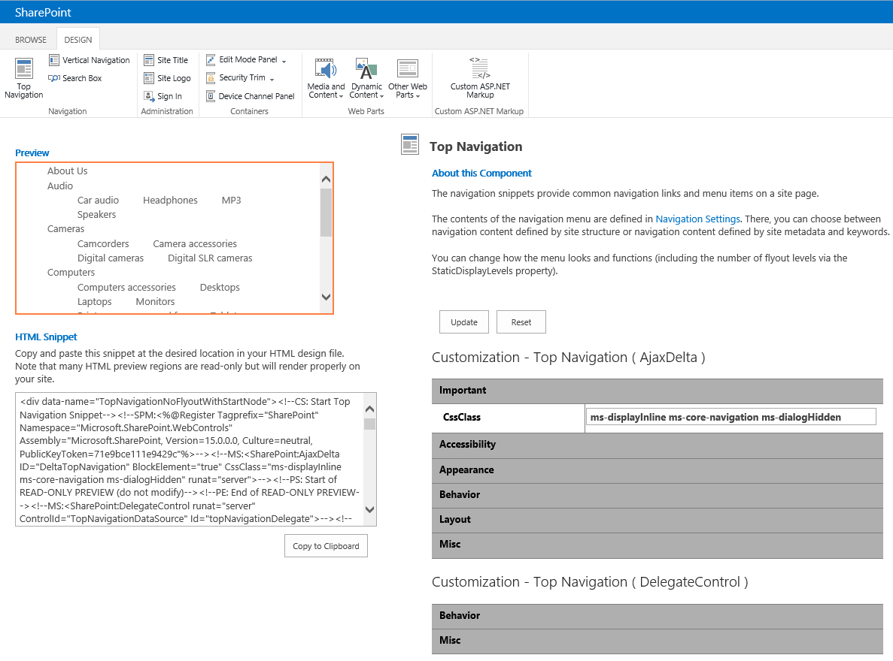
Adding SharePoint Components

Slide 23
Optimizing for Mobile Devices
Define “channels” for one or more devices
Assign alternate master page per channel
Selectively include/exclude portions of page layout per channel
Preview the designs while authoring content
Notes:
New to SharePoint 2013 are channels. A channel can be associated with a master page allowing for specific branding implementations for specific devices. Each channel is tied to a device using User Agent strings.

Slide 24
Design Manager
demo

Slide 25
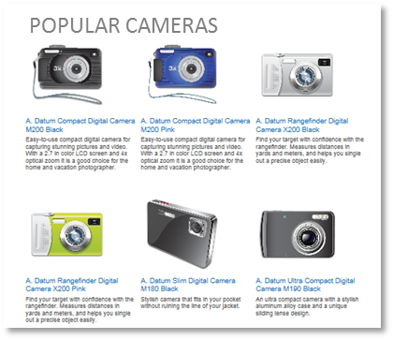
Usage Analytics
Built for scale from the ground up
Detail data rolled up every 15 days & anonymize
Daily events purged every 15 days; monthly events after 3yrs
Lifetime counts always retained
Counts views & unique items/day
Shows recent (2-weeks) and lifetime count
Trims least visited content
Pushes aggregate data to reporting database
Drives recommendations capabilities on content
Calculations injected into search index as sortable managed properties
Deep integration with search engine
Can influence search relevance based on content usage
Includes preconfigured CBS Web Part – “Top Pages”
Notes:
Microsoft has completely replaced the analytics engine in SharePoint 2010 with a new one written from scratch and built for scale from the ground up in SharePoint 2013. This engine is used to drive recommendations for content in a site showing content people will most likely be interested in based on the browsing activities of other users on the site.

Slide 26
Usage Analytics - Extensibility
Can export data from reporting database
Export to Excel for 15 days & 36 months
Every 15 days data rolled into partial months; detail purged
Can customize the VIEW event weight
Can create custom events (12 max/tenant)
View two items = recommendation weight of 1
*Buy two items = recommendation weight of 10
*FaceBook “like” two items = recommendation weight of 5
Custom events submitted via JavaScript
* = sample custom events developers can define
Notes:
Developers can extend the analytics engine using custom events. A customer could change the weighting for a specific event based on their own custom criteria. For instance, when someone rates a page, you could set the weight of that event to be much higher than that of simply browsing a page.

Slide 27
Variations Site Improvements
Improvements from SharePoint 2010
Faster, repeatable and more reliable
Smaller export packages (vs. one big job)
Replication list generated so can be restarted if interrupted
Can publish one or more labels at once
Page’s metadata emits page’s language for search engines
Machine based translations via Bing translation service
Optionally replicate entire lists / libraries
Notes:
The new search based sites and managed navigation make it much easier to implement multilingual sites in SharePoint 2013. In addition to these improvements Microsoft added implemented other changes for multilingual sites.
It creates a list of things to export which allow for very easy start & stop of the replication of content. Users can also elect to replicate an entire list or multiple lables at once, which are two challenges we had in previous versions of SharePoint.

Slide 28
Other Multilingual Site Improvements
Map http://foo/fr-fr » http://foo.fr for desirable URLs
Enabled by Cross Site Publishing & Host Header Site Collections
Export / import content for translation by 3rd party
Uses industry standard XLIFF file format
Can include entire label, one page & even navigation
Instead of pushing updated content, label owners are notified of changes & pull content on demand
Site owner can also opt out of getting additional updates
Notes:
Content can be automatically translate the content using the Bing translation service or exported for 3rd party translation. After the content is translated, it can then be imported back into SharePoint. In addition, the navigation taxonomy can be exported for external translation as well for multilingual friendly URLs.

Slide 29
Summary
SharePoint 2013 WCM Platform Improvements
Managing Content, Navigation and Authoring
Content Reuse
Branding Sites
Usage Analytics
Multilingual

Slide 30
Q&A

Slide 31

© 2012 Microsoft Corporation. All rights reserved. Microsoft, Windows, Windows Vista and other product names are or may be registered trademarks and/or trademarks in the U.S. and/or other countries.
The information herein is for informational purposes only and represents the current view of Microsoft Corporation as of the date of this presentation. Because Microsoft must respond to changing market conditions, it should not be interpreted to be a commitment on the part of Microsoft, and Microsoft cannot guarantee the accuracy of any information provided after the date of this presentation. MICROSOFT MAKES NO WARRANTIES, EXPRESS, IMPLIED OR STATUTORY, AS TO THE INFORMATION IN THIS PRESENTATION.

